Slide 1
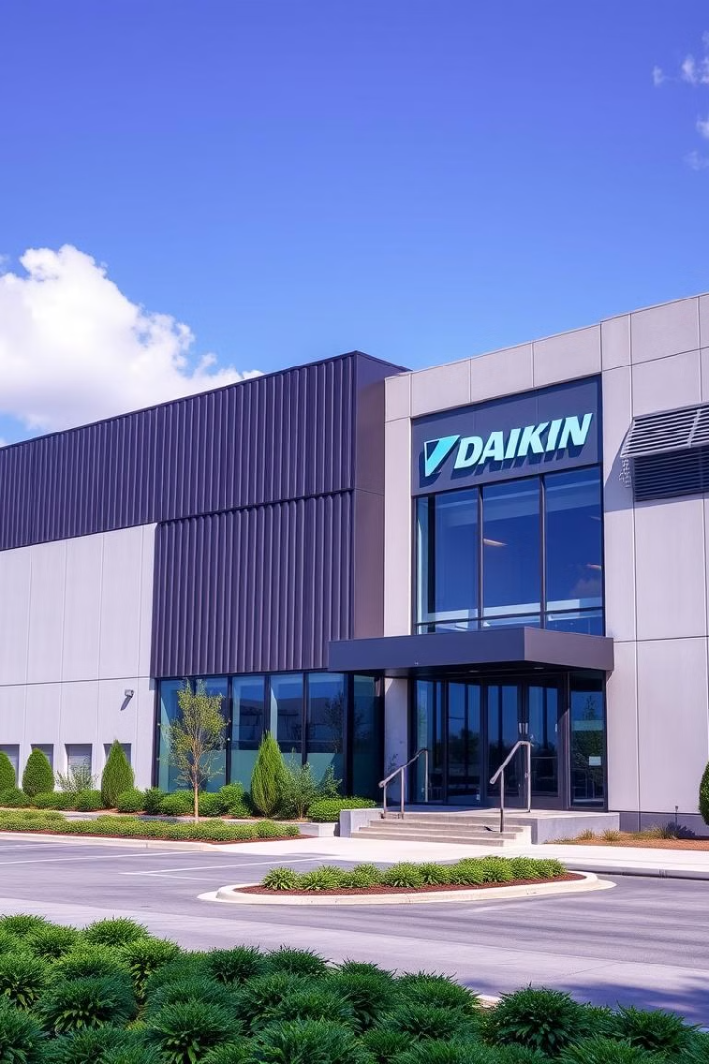
Daikin Manufacturing Excellence
This presentation highlights our industrial visit to Daikin. We will explore their manufacturing plant and DJIME. Our report focuses on processes, analysis, observations, and recommendations. Daikin India's turnover is INR 5,000 crore, with 3 manufacturing facilities producing 1.25 million AC units yearly.
Location: Neemrana, Rajasthan
Objective of Visit: To understand Daikin's manufacturing processes, Japanese shop-floor practices, and skill development initiatives at DJIME.
Name: OISHIK BANERJEE
055028
Notes:
1

Slide 2
Problems & Objectives
Problem Statements
Objectives
Bottlenecks in manufacturing.
Analyze production efficiency.
DJIME training effectiveness.
Evaluate DJIME's impact.
Implementation of Lean, Kaizen.
Optimize manufacturing.
Quality & efficiency challenges.
Reduce waste by 15%.
Skill shortage in the HVAC industry in India.
To explore Daikin’s advanced manufacturing technologies.
Need for high-quality manufacturing aligned with Japanese standards.
To understand the role of DJIME in workforce skill development.
To analyze the implementation of Kaizen and other Japanese methodologies.
Notes:
2

Slide 3
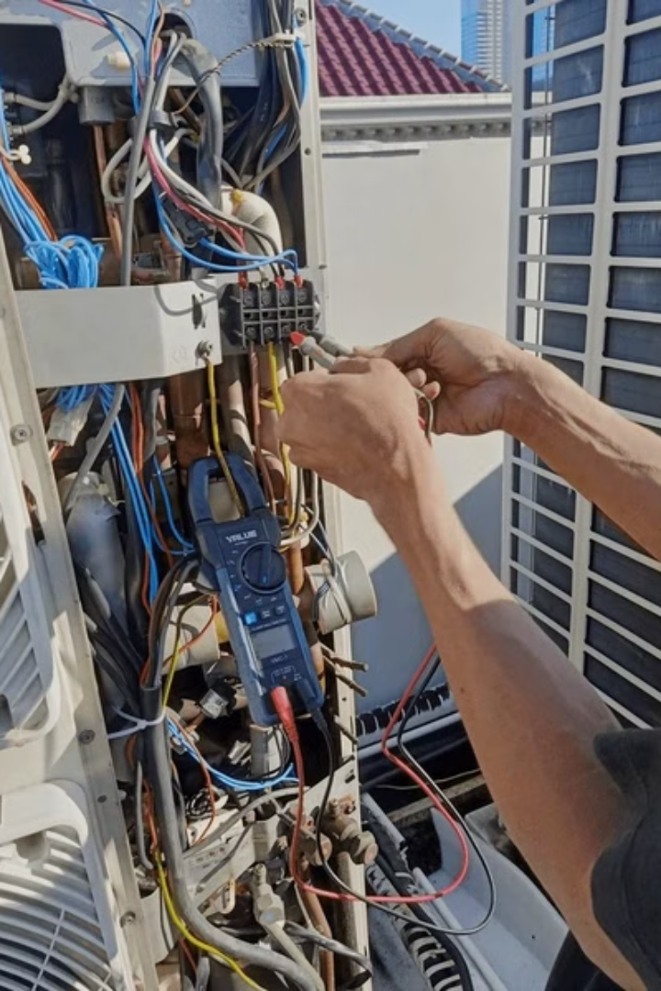
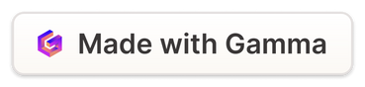
Data-Driven Analysis
1
Data Collection
Process observation. Interviews with plant personnel. Public data from reports.
2
Value Stream Mapping
Waste identification in AC lines. Target 10% lead time reduction.
3
Statistical Analysis
Production output. Defect rates. Cycle times.
4
Benchmarking
Compare Daikin to Toyota's system. SWOT analysis.
Notes:
3

Slide 4
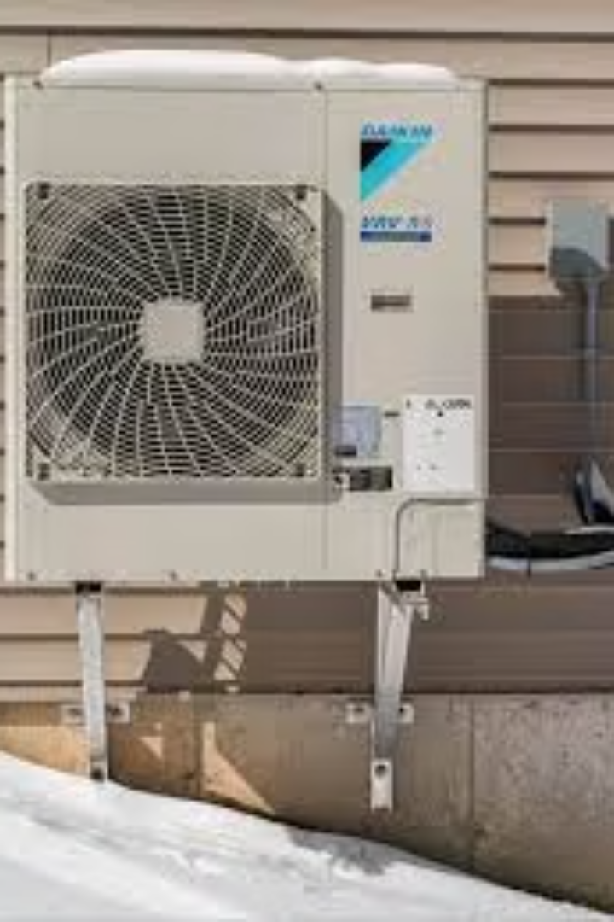


Key Observations
Daikin Plant
DJIME
Lean principles (5S). Automation in assembly. Quality control. Kaizen activities.
Hands-on training. Japanese techniques. Simulation technologies. Collaboration with experts.
High emphasis on safety, quality control, and lean manufacturing principles (Kaizen).
Advanced automation in production lines for air conditioners.
DJIME’s curriculum includes both technical training and soft-skills enhancement.
Strong focus on sustainability through energy-efficient products and processes.
Notes:
4

Slide 5
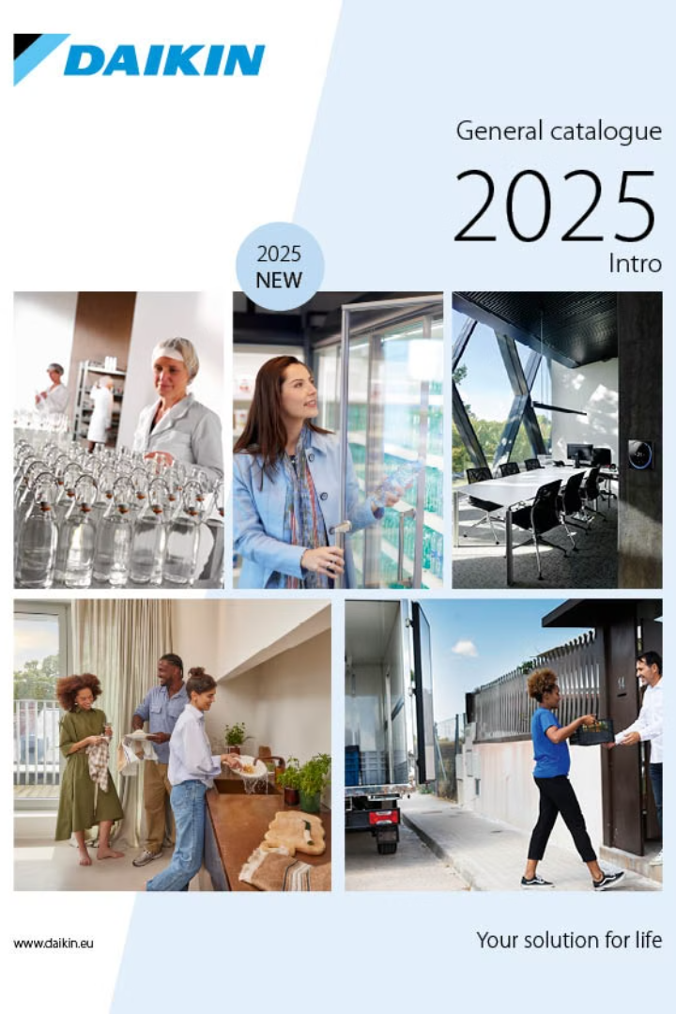




Insights & Recommendations
Managerial Insights
Commitment to quality. Employee training. Effective Japanese principles. DJIME's potential.
Supply Chain
Optimize to reduce lead times and inventory costs.
Advanced Tech
Invest in AI and IoT for process monitoring.
KPIs
Develop KPIs to measure project effectiveness.
Notes:
5

Slide 6
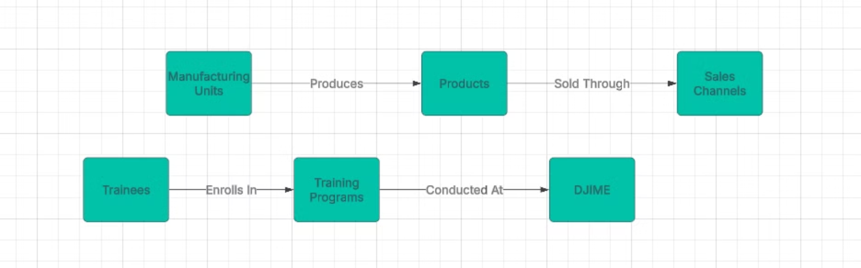
Project Statistics & ERD
Project Statistics
ERD Diagram
Workforce Trained at DJIME: ~1,00,000 (as of March 2025).
Suppliers -> Raw Materials -> Production Lines -> Products -> Customers -> Orders -> Employees -> Equipment
Manufacturing Output: [Insert relevant production numbers if available].
A visual ERD Diagram is needed to represent the relationships.
Automation Level: High (use of digital diagnostic tools).
Notes:
6

